Slide 1
Training set: ColorFERET data for all runs
  10-fold cross validation
    Accuracy: ~98%
  Test set: LFW
    No gender metadata, so used genderize.io API to predict gender from name
    Accuracy: ~97%
  Test set: FDDB
    No metadata: performance cannot be evaluated
    Accuracy: Unknown
    Shows prediction can be made on a large scale

Slide 2
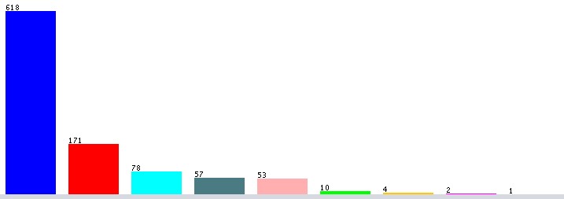

Trait Prediction: Race
ColorFERET: only database with race metadata
  10-fold cross validation to prevent overfitting
  9 races—Accuracy: ~85%
  3 most common races:
    Asian, Black/African-American, White
    Accuracy: ~97%

Slide 3
Facial Recognition: Introduction
Step 2: Projecting Faces
  Find 68 facial landmarks
    Approach invented by V. Kazemi and J. Sullivan, 2014
  Tilted or turned faces can be straightened by shearing

Slide 4
Databases
Face picture data with metadata (trait information)
  ColorFERET (Facial Recognition Technology)
    ~1,200 unique subjects
    Metadata: Race, gender, YOB, year photo taken
  Labeled Faces in the Wild (LFW)
    ~5,700 unique subjects
    Metadata: Full name
  Face Detection Data Set and Benchmark
    ~4,000 faces detected
    Metadata: None
  IMDb-Wiki Database
    ~20,000 unique subjects
    Metadata: Gender, YOB, year photo taken

Slide 5
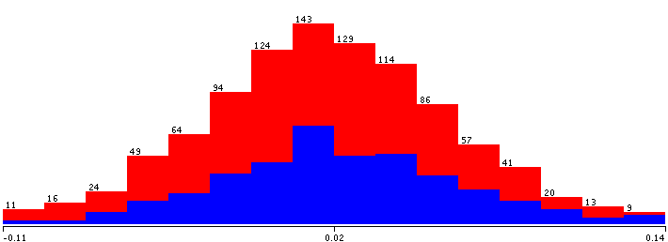
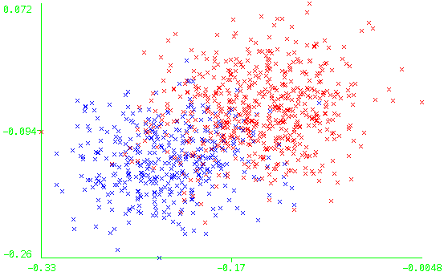
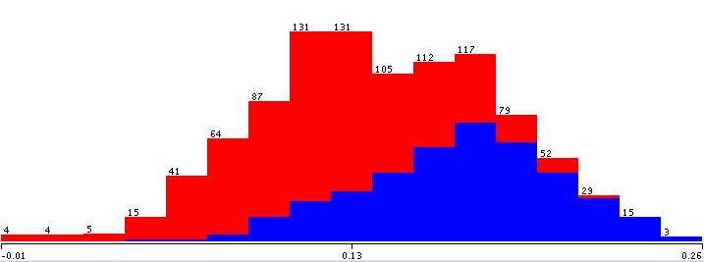
Trait Prediction
Not useful attribute
Useful attribute

